Slide 1


Harmonizing Taxonomy and Terminology across Force-Based Manipulation
(Manual Therapy) Research Disciplines
Chad E Cook PT, PhD, FAPTA
Professor
Duke University
MPI of ForceNET
Director of the Center for Duke Excellence in Manual and Manipulative Therapy

Slide 2
Part One: Introduction of the “state of the science” of force-based manipulation

Slide 3
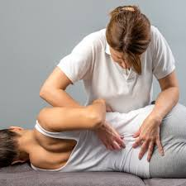

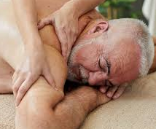
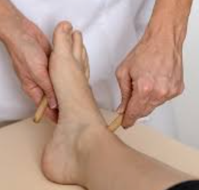
Force-Based Manipulations
Force-based manipulations (FBM) involve the passive application of mechanical force to the body’s exterior with therapeutic intent and are recognized as a complementary and integrative health approach.
https://pubmed.ncbi.nlm.nih.gov/38078829/

Slide 4
Increasing Use of FBM
According to the National Health Interview Survey (NHIS) conducted by the National Center for Complementary and Integrative Health (NCCIH), 36.7% of American adults reported using at least one complementary health approach in 2022.
In particular, use has increased among those in chronic pain, those who have experience failed traditional medical care, and those who are looking for options other than pharmaceutical choices.
Chen L, Michalsen A. Management of chronic pain using complementary and integrative medicine. BMJ. 2017;357:j1284

Slide 5

Key Stakeholders/Research Scientists
Basic scientists
Movement scientists
Imaging specialists
Biomechanical engineers
Consumers
Clinical scientists
Physiotherapists
Chiropractors
Osteopaths
NIH and other funding sources
Policy Makers
Healthcare Organizations
Professional Associations

Slide 6
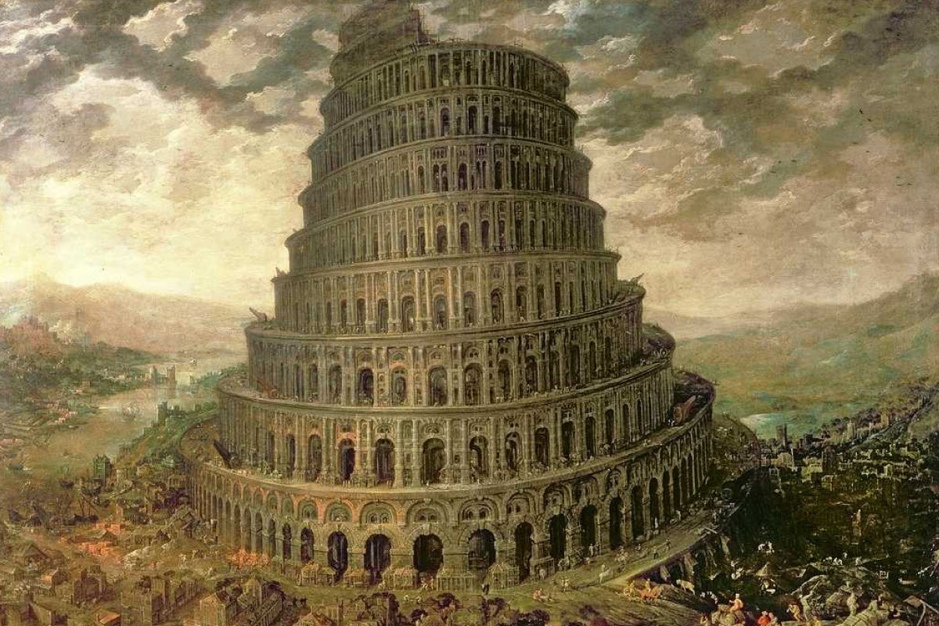

Slide 7
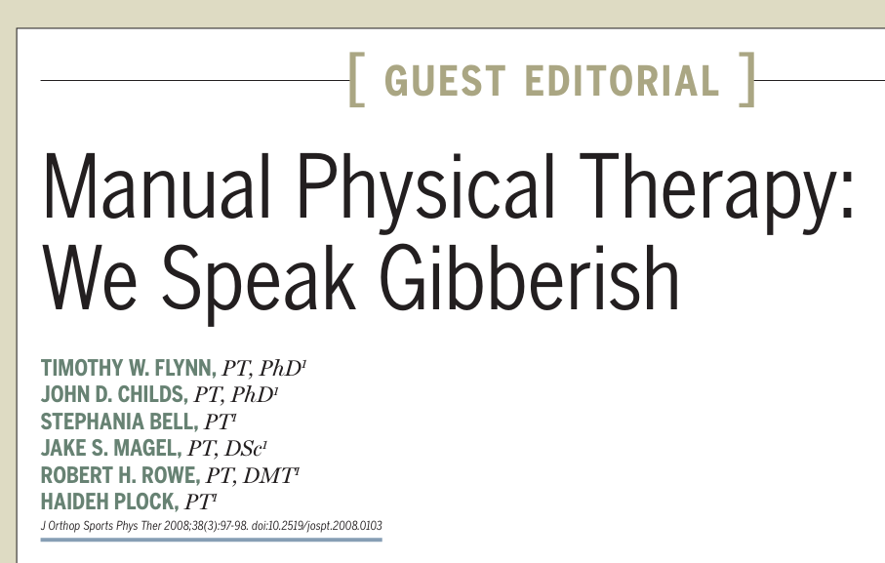
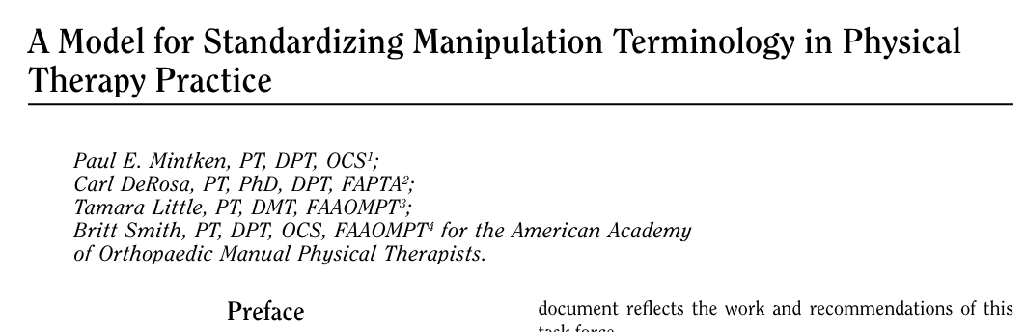
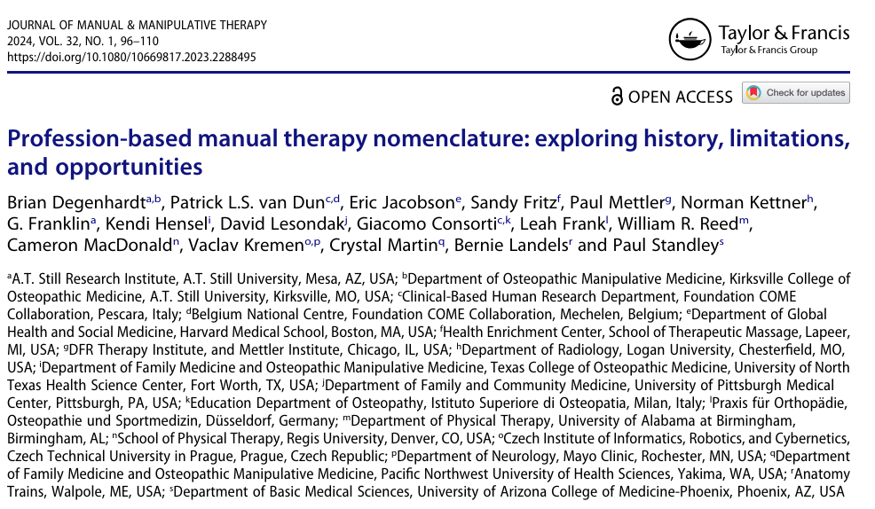
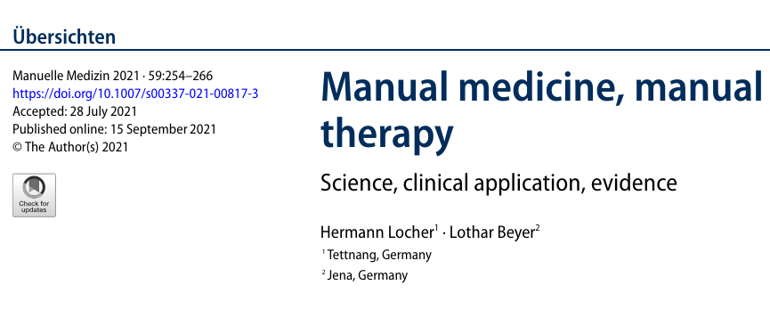

Slide 8


Slide 9




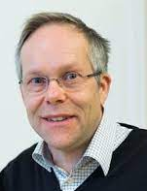
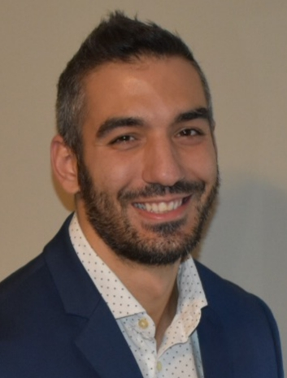





Framework and Taxonomy Working Group Members
Chad Cook
Terry Loghmani
Beth Winkelstein
Geoffrey Bove
Håkan Olausson
Damian Keter
Medha Pathak Ignasi Casanellas Katalin M. Gothard Thomas Bulea Theanne Griffith
Notes:
Geoffrey Bove, BoveLabs CRO
Beth Winkelstein, Penn
Terry Loghmani, Indiana University

Slide 10
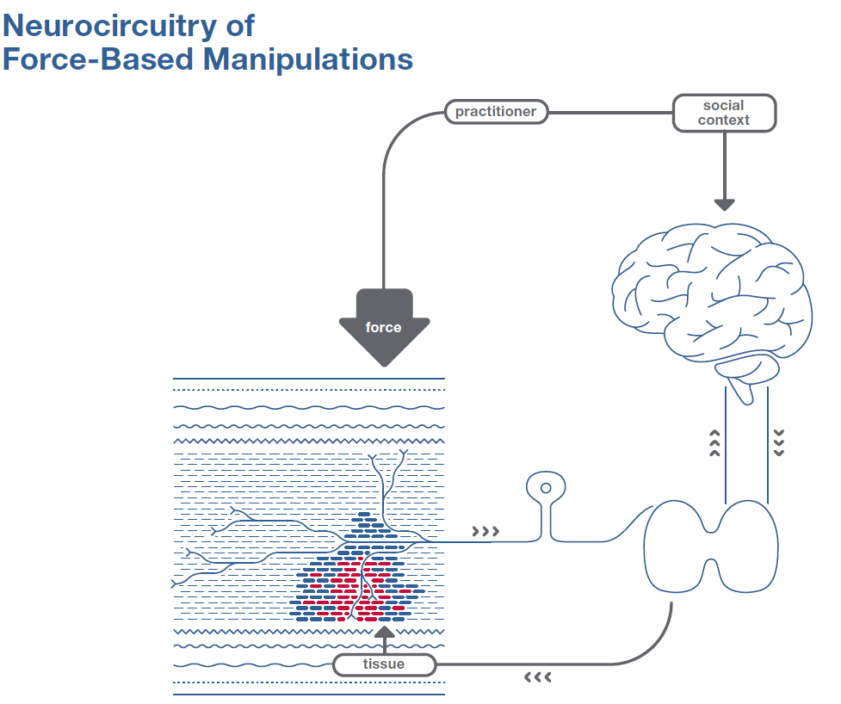
Working group is charged with refining the proposed framework, including, complete representation of physiological responses to force, standardizing languages, and building a taxonomy on potential moderators of force (i.e., application domains, force continuum, etc).

Slide 11
Targeted Deliverables
Common terminology and taxonomy for force-based manipulation nomenclature and classification
A standardized “force” document
A model to guide force-based manipulation research
Classifications of the term “treatment mechanism” including differentiation of causal and associational mechanisms
Publications outlining gaps in FBM mechanism research and blue sky objectives

Slide 12
Presentation Purpose
Discuss the force document, including standardization of language, mediators and types
Outline the model that is used to guide FBM research
Describe the FBM compendium, which will provide a framework for the public and serve as an operation’s manual for future FBM grant submissions

Slide 13
Part Four: The Force-Based Manipulation Compendium

Slide 14
The Compendium
  Chapter One: Defining and outlining mechanisms’ and FBM classifications;
  Chapter Two: Factors to consider when performing or researching FBM (previously discussed);
  Chapter Three: Taxonomy of response (treatment); mechanisms;
  Chapter Four: Research implications;
  Chapter Five: Clinical implications;
  Glossary.

Slide 15
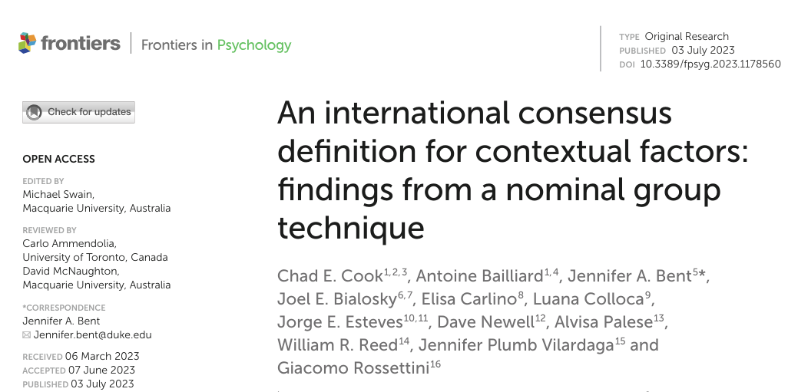
Chapter One: Defining and outlining mechanisms’ classifications

Slide 16

Categorizing Treatment Mechanisms into Causal and Associational Groups

Slide 17
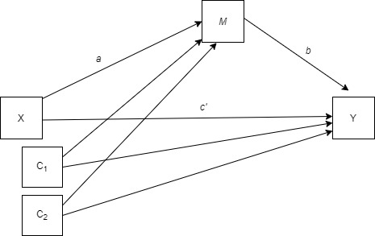
Causal Treatment Mechanisms’ Designs Paper
Paper in process
Includes FBM researchers and biostatisticians
Outlines the appropriate research design models to identify causal treatment mechanisms
Expected completion in May, 2025

Slide 18
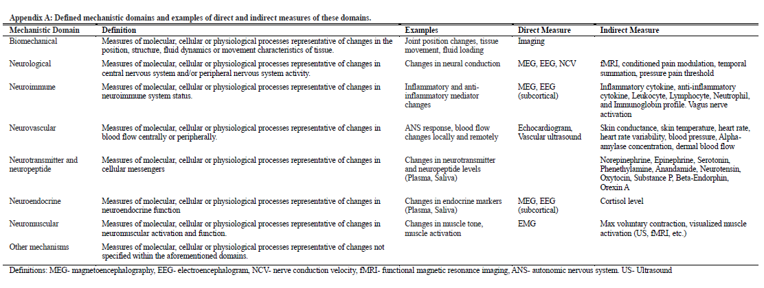
Chapter Three: Taxonomy of response (treatment); mechanisms
PLOS One: Paper is in Press

Slide 19
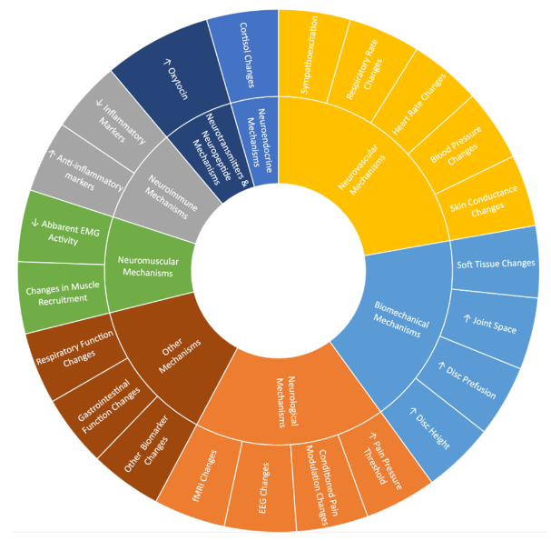

Slide 20
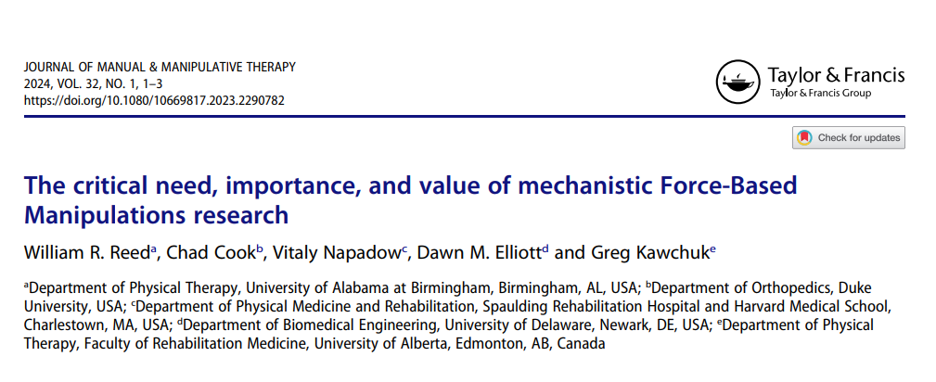
Chapter Four: Research Implications

Slide 21
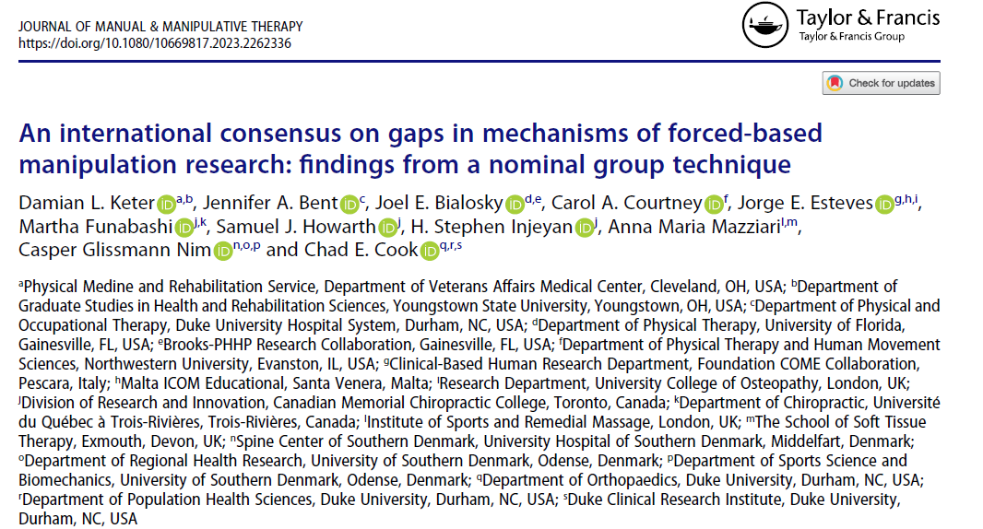
International “Gaps” in FBM Mechanisms Research

Slide 22
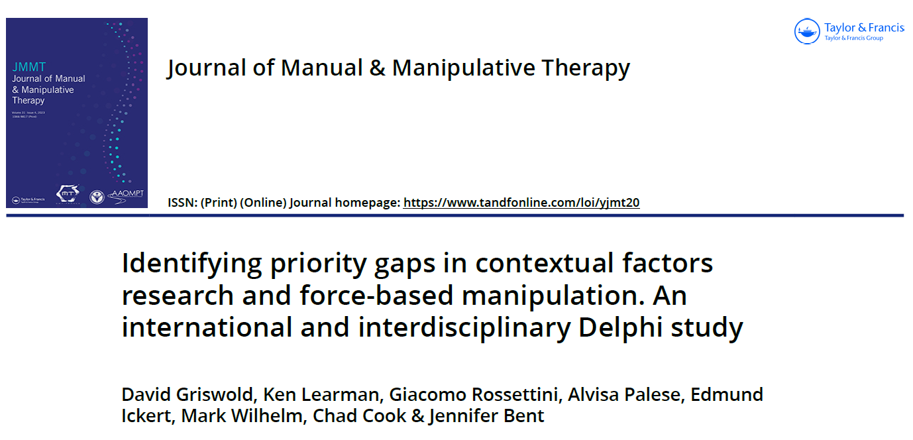
International “Gaps” in Contextual Factors and FBM Research

Slide 23


Slide 24

Waste in FBM/SMT Research

Slide 25

Outlining the Role of Specific and Shared Treatment Mechanisms

Slide 26


Slide 27

Chapter Five: Clinical Implications

Slide 28


Slide 29
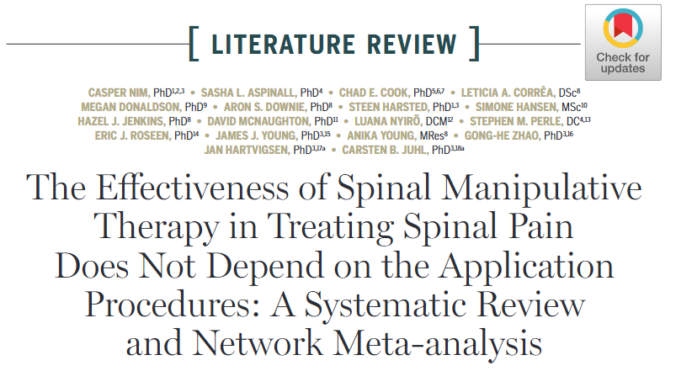

Slide 30
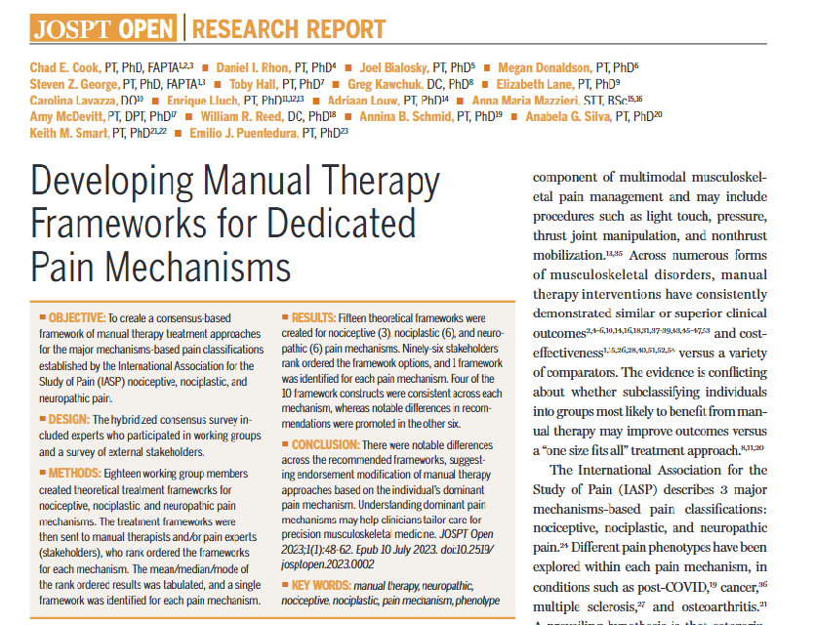

Slide 31


Slide 32
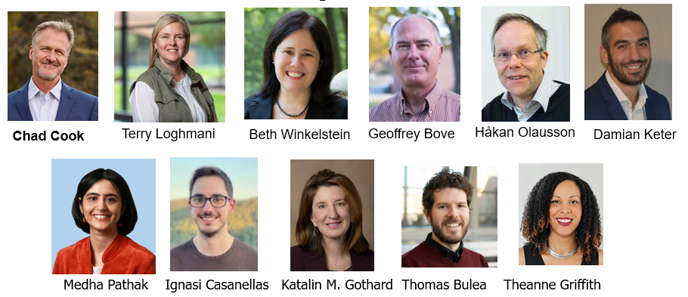
Glossary
Over 300 critical terms defined and alphabetized

Slide 33
Harmonizing Nomenclature

Slide 34
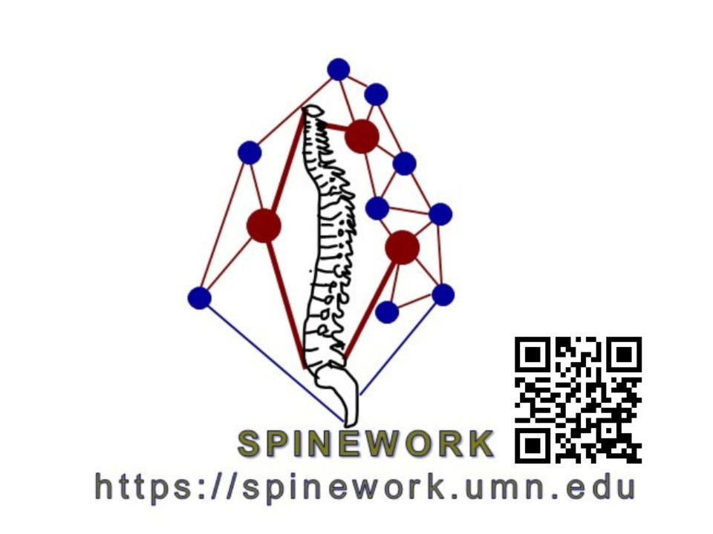

“What’s in a name?”
Standardizing force types, modifications and moderators/mediators
Beth A. Winkelstein, PhD
Spine Pain Research Lab
Bioengineering &
Neurosurgery
University of Pennsylvania

Slide 35
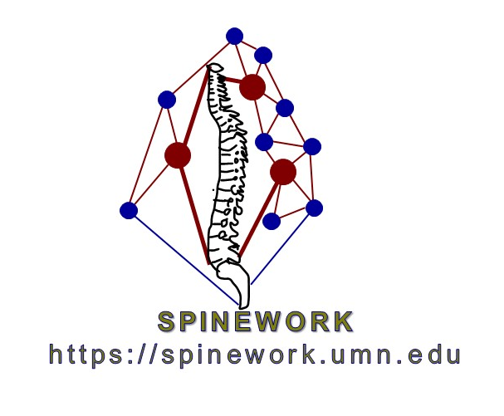
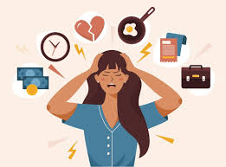
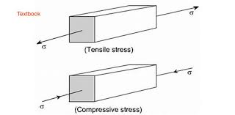
Terminology & need for shared lexicon
“STRESS”
World Health Organization ‘state of worry or mental tension caused by a difficult situation’
Biomechanist ‘force over a cross-sectional area’
Cellular Physiologist ‘state of dysfunction’
Pain Practitioner ‘a state of pressure or dysregulation’
Force-Based Practitioner ‘pressure’
Computational Modeler described by an equation….

Slide 36
Terminology & need for shared lexicon
“STIFFNESS”
extent to which an object resists deformation (Fung 1993, Humphrey 2002)
sensation of difficulty in movement (Orbai et al 2014, Stanton et al 2017)
“STRAIN”
Simple words highlight challenges working across disciplines and
the need for common understanding about, and use of, terminology.”

Slide 37
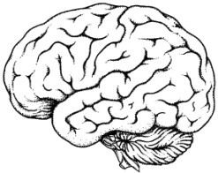

Regulation of Function, Dysfunction & Pain
PAIN
STIMULUS
Aδ & C fibers
afferents
CENTRAL (CNS)
LOCAL (periphery)
Dorsal Horn Excitability
Electrophysiologic
Signaling
Decreased threshold,
Increased response to stimuli,
Ongoing spontaneous activity
Structural & Material
Responses
Neuromodulator Release
(SP,CGRP)
Neuroimmune Activation & Inflammation
Glial activation,
Cytokine & chemokine upregulation/release,
Altered synaptic transmission
Inflammation
& Immune Responses
Algesic Mediator Induction & Release
Edema
SP, CGRP, prostaglandins, glutamate, NO

Slide 38
Force Parameters
Complex & ‘in the intersection’
FBM – complicated by provider & receiver
Overall Consideration:
Dosing (extent of treatment)
Controlled vs Subjective
Feedback (subject & tissue)
Contributing to Dosing
Magnitude
Angle
Direction
Area
Rate
Frequency
Pattern
Mode

Slide 39
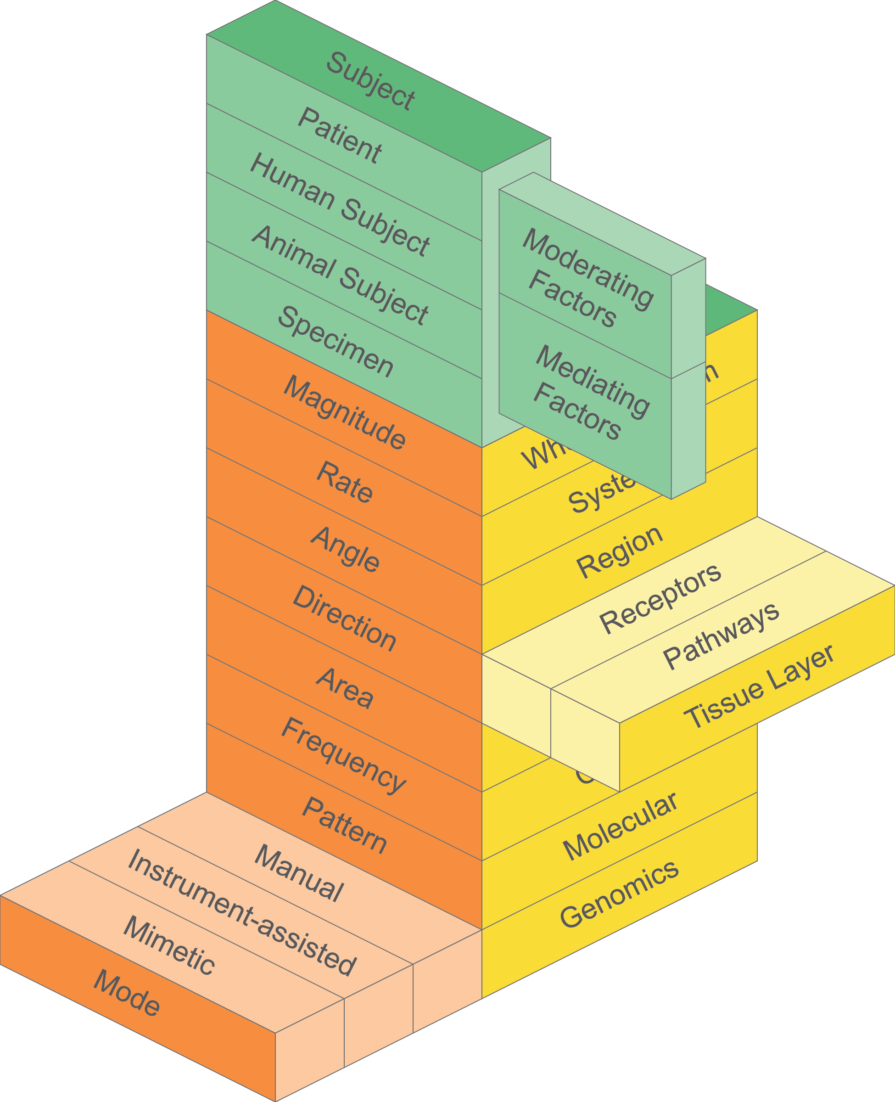
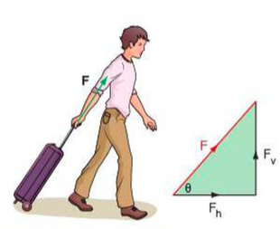
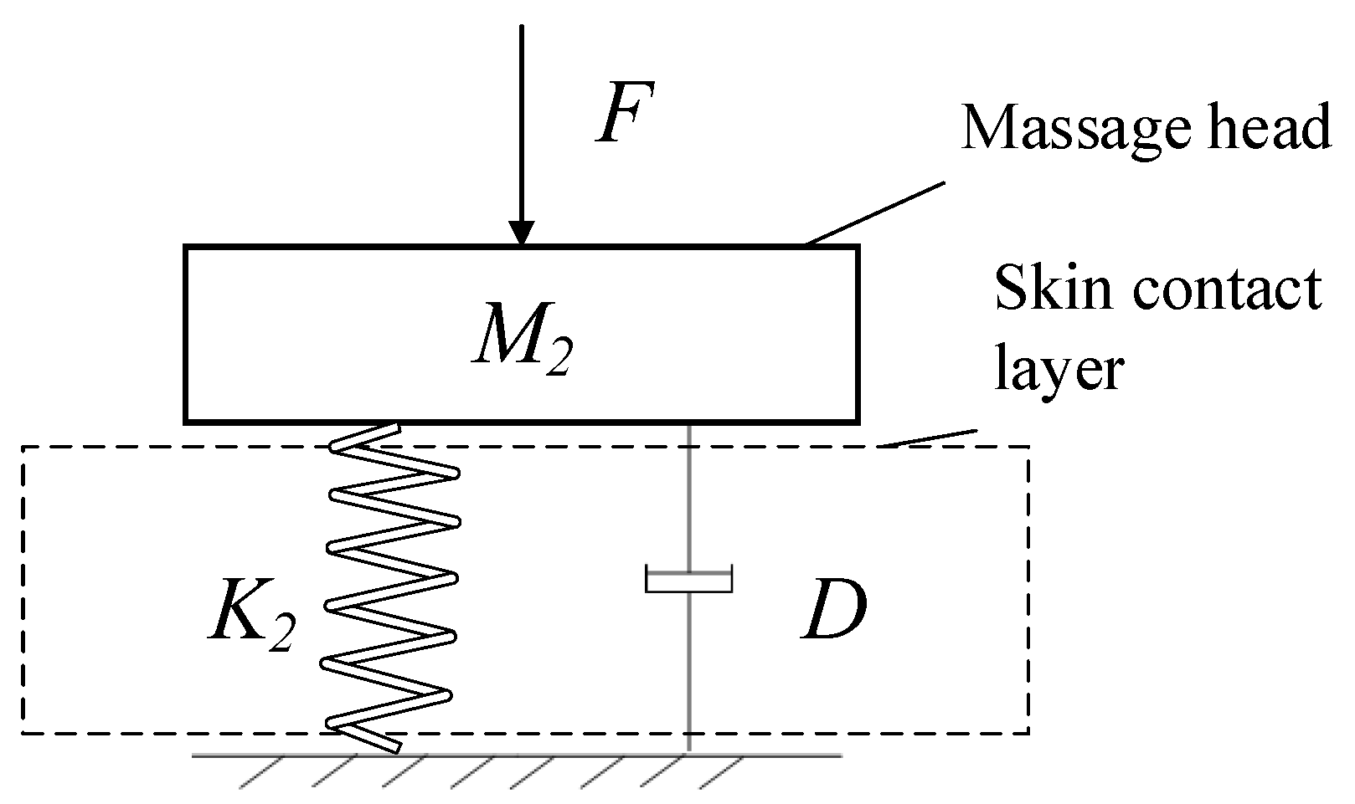
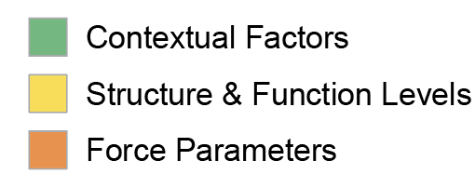
Force Parameters
Contributing to Dosing
Magnitude
Angle
Direction
Area
Zhou et al 2022, Micromachines

Slide 40
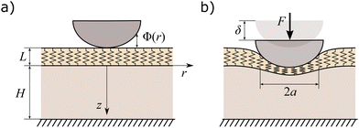
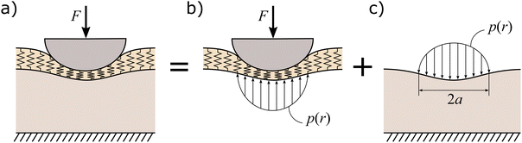
Force Parameters
Contributing to Dosing
Magnitude
Angle
Direction
Area
Argatov et al 2023, Royal Soc Chem

Slide 41
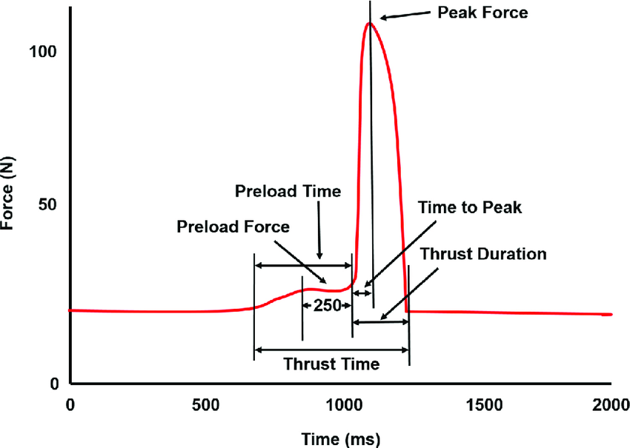
Force Parameters
Contributing to Dosing
Magnitude
Angle
Direction
Area
Rate
Frequency
Colloca et al 2020, JMPT

Slide 42
Force Parameters
Contributing to Dosing
Magnitude
Angle
Direction
Area
Rate
Frequency
Pattern
Mode

Slide 43
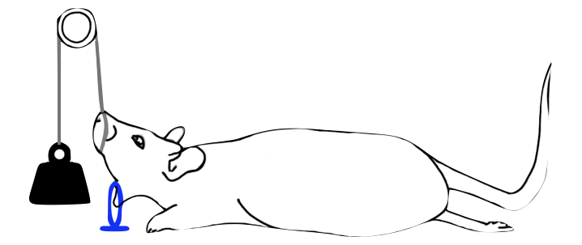
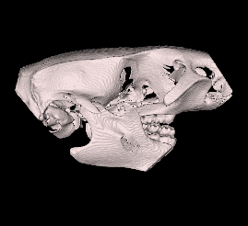
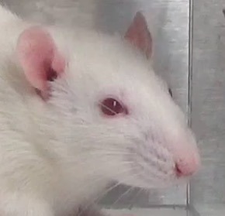

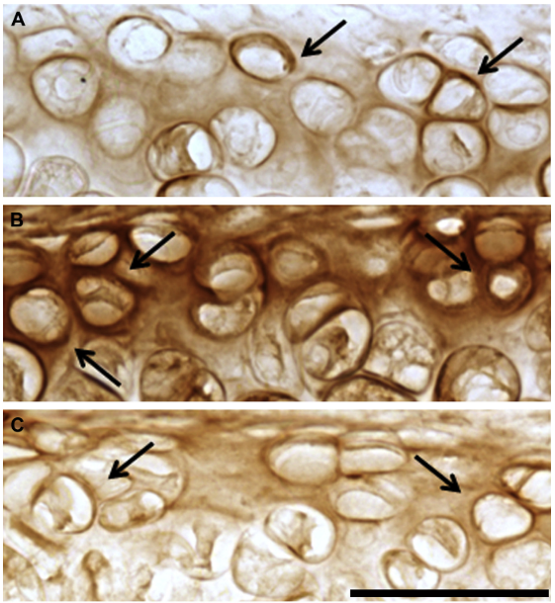
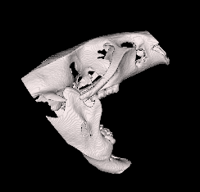
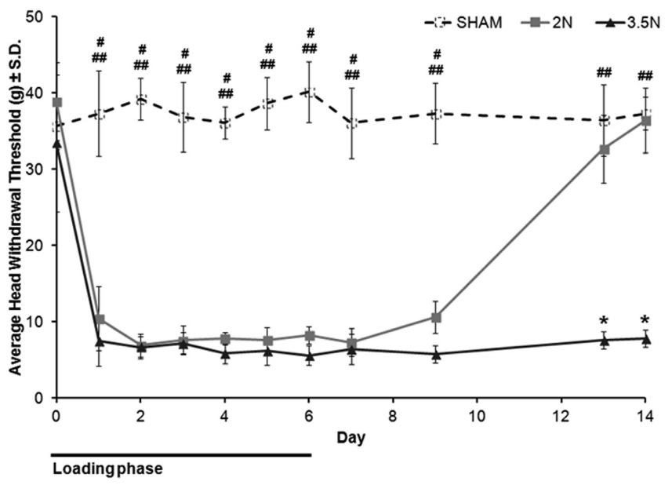
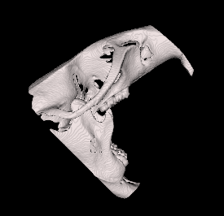

Example of Regulation Effects - Force
7
sling
loop
IACUC-approved
0N
TMJ Sensitivity
TNF-⍺ in TMJ cartilage
day 7
2N
2N
0N
3.5N
2N
PAIN
3.5N
3.5N
0N
(Nicoll et al. 2010; Kartha et al. 2016; Sperry et al. 2018)

Slide 44
Example of Regulation Effects - Force
(Sperry et al. Pain, 2021)

Slide 45
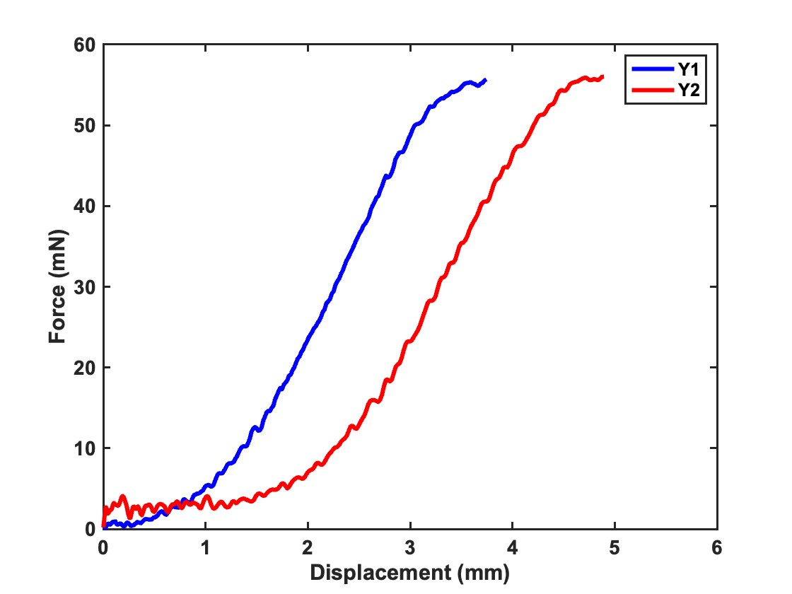
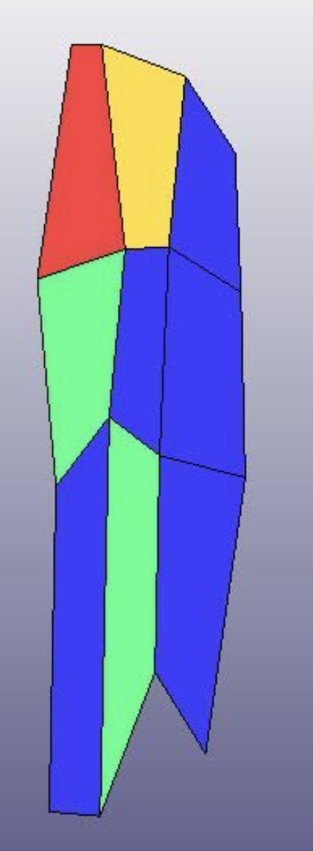
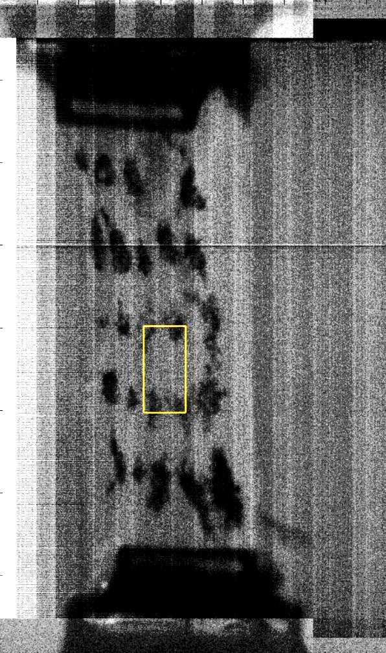
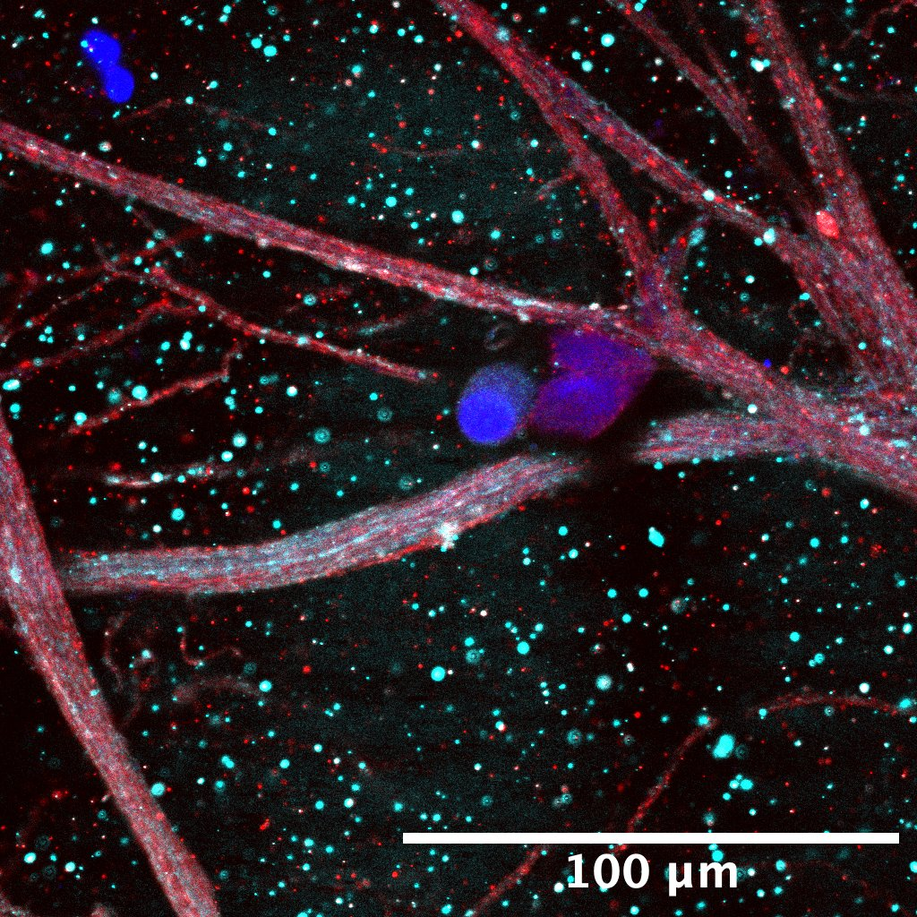
Regulation Effects – Rate on Neuronal pERK
Failure
Loading mechanics
  7.9±0.3 mm/s
  122±16.5 %/s
(Zhang et al, J Biomech Eng, 2016)
(Nuethong et al., 2022; Singh & Winkelstein, 2019)

Slide 46
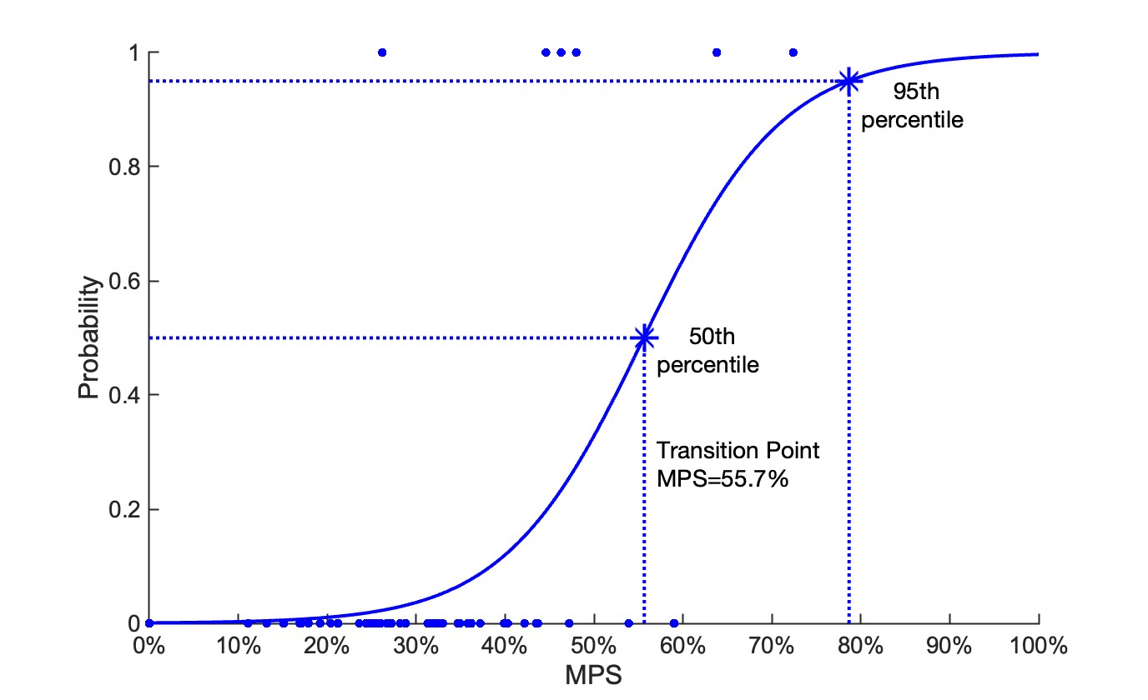
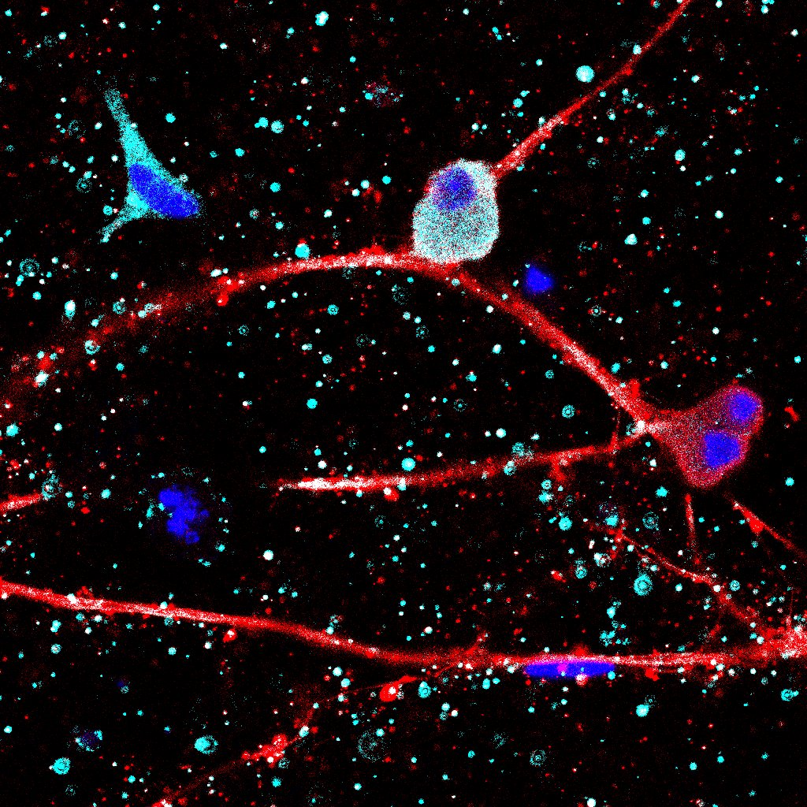
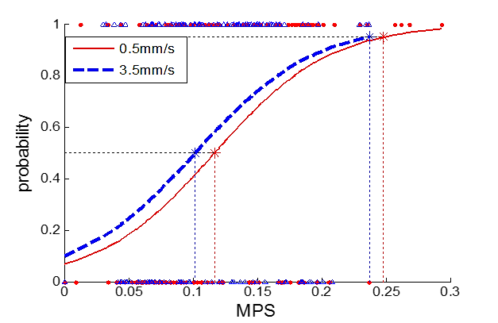
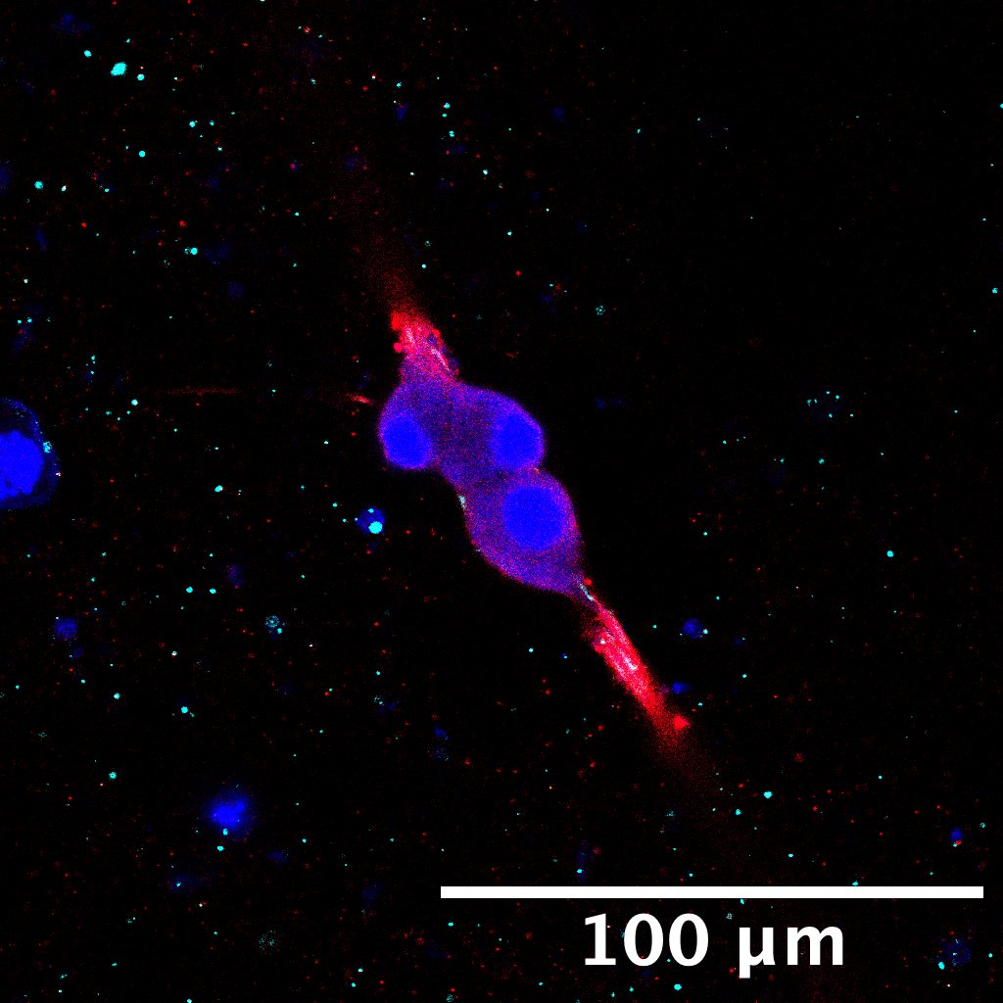
Regulation Effects – Rate on Neuronal pERK
95th
78.7% (76.7-78.9%)
10.2%
11.7%
50th
55.7% (55.6-56.6%)
(Zhang et al, J Biomech Eng, 2016)
(p=0.005)
Notes:
Gel 5 E7 001
Gel 5 E6 003
Average control pERK - 1.341282694 ± 1.596586304
Average control colocalized - 0.5863390471 ± 0.9147863026
Average loaded pERK - 1.016493584 ± 1.975015288
Average loaded colocalized - 0.2821817790 ± 0.5399607625
Normalized - take each individual data point and average/std that

Slide 47
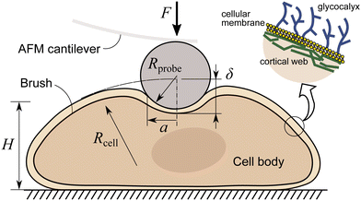
Mediators & Considerations
  Scales
    Independent
    Integrative
  Systems & Function
    Individually
    Cross-talk
    History (cells & systems)
Notes:
Network products

Slide 48


A Model to Guide
Force-Based Manipulation (FBM) Research & Practice
Manual Therapy is a Powerful Force
in Healing, Repair, Regeneration
Well-Being and Health
M. Terry Loghmani, PT, PhD, FNAP
Associate Professor
Indiana University Indianapolis
NeuronS_MATTR

Slide 49
Model to Guide FBM Research & Practice
PROBLEM: The lack of conclusive evidence regarding FBM mechanisms and clinical effectiveness of FBM threatens the validity, reliability, and equitable availability of these non-invasive approaches.
PRIORITY: NIH RFA (AT-21-006) established priority objectives to meet the need for collaboration and dissemination of:
Terminology and characteristics of measurement of FBM
Contextual effects of FBM to support mechanisms research and incorporation of relevant technology and methods

Slide 50
Model to Guide FBM Research & Practice
PURPOSE: A model to support FBM research study design and grant proposal development, with the goal of improving safety, optimizing practice, and advancing understanding in the field.
PREMISE: The model should :
Be relevant across multiple disciplines
Support inter-disciplinary FBM research and healthcare

Slide 51
FBM Taxonomy
& Terminology Committee
3 NIH U24 Networks
3 Models
Proposed
Presented virtually
3D Matrix
Model Selected
Sub-group refined
Multi-disciplinary
Discussed
Voted On (2 rounds)
Met regularly
Virtual/Email
Dissemination
Model to Guide FBM Research & Practice
PROCEDURE:

Slide 52
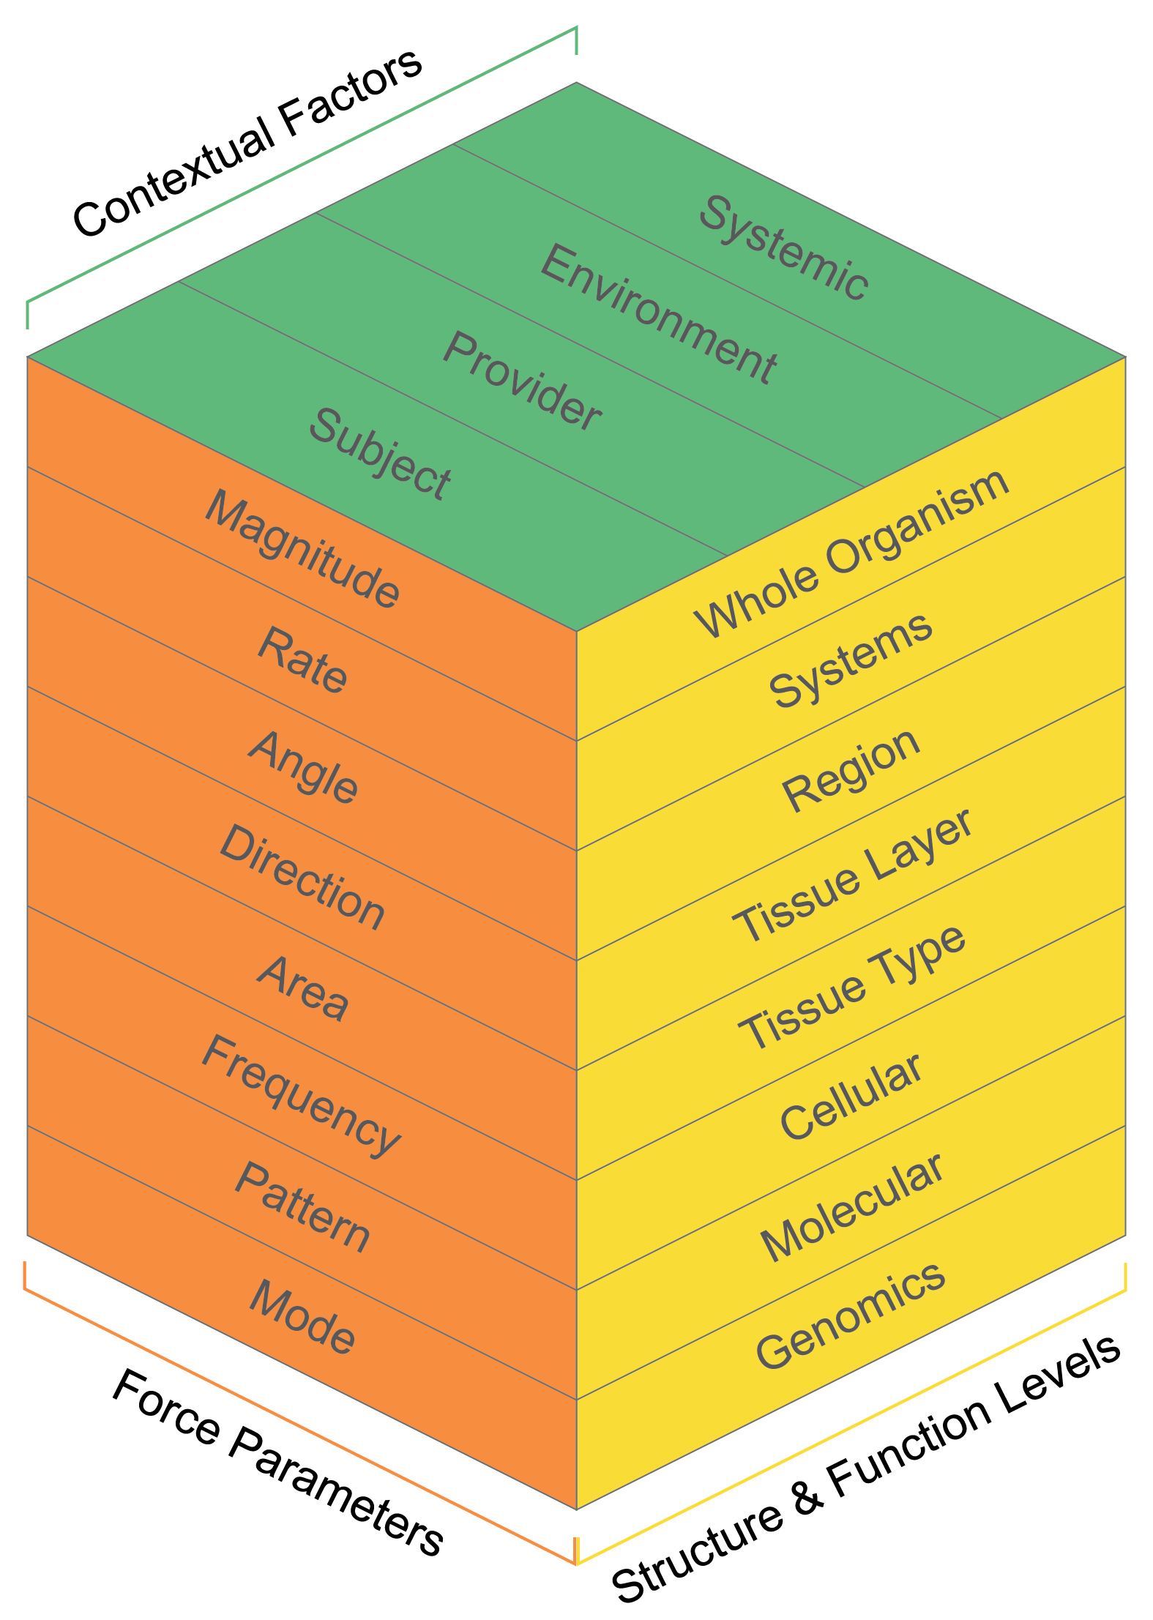
A 3D Model to Guide FBM Research & Practice
3D MATRIX MODEL
1. ELEMENTS

Slide 53

A 3D Model to Guide FBM Research & Practice
CONTEXTUAL FACTORS
The intrinsic and extrinsic components that moderate treatment mechanisms of interventions, including manual therapy. -Cook, et al., Front Psychol, 2023
-Keter, et al., IJOM, 2025

Slide 54
A 3D Model to Guide FBM Research & Practice
STRUCTURE &
FUNCTION
LEVELS
Organism
Gene
Molecular
System
Region
Tissue Layer
Cellular
Tissue Type
Can consider the levels of organization of the body from different perspectives:
Structural
Functional
Performance
Process
Interaction

Slide 55

Different magnitudes
Rate (2.5cm/s); Maintained contact
45° angle of application
Uni-directional; away from spine
2.5 cm X 2cm area treated
1 Hz; X 10sec; 1 session
Linear stroke pattern; random order
Quantitative IASTM; Clinician
FORCE PROFILE
A 3D Model to Guide FBM Research & Practice
Force
Parameters
Applied force should be described & quantified.
Replication & reliability.
Needed to establish FBM dose-response.
5N
10N
15N

Slide 56
A 3D Model to Guide FBM Research & Practice
2. INTERACTIVE
Levels can be “opened up ” to more specific and deepening sub-levels.

Slide 57

A 3D Model to Guide FBM Research & Practice
3. INTEGRATIVE
Considers the intersection of the elements, levels, and sub-levels for FBM mechanisms research.

Slide 58

A 3D Model to Guide FBM Research & Practice
4. TRANSLATIONAL
Considers the intersection of the
elements, levels, and sub-levels for translational research on FBM approaches, including clinical outcomes.

Slide 59

A 3D Model to Guide FBM Research & Practice
4. DYNAMIC
Can expand to include additional levels &
sub-levels as needed and new approaches or knowledge is acquired.

Slide 60
IMPLICATIONS
Research
Design & Proposals
Clinical
Best Practice & Judgement
Education
Training & Preparation

Slide 61
CONSIDERATIONS
Patient/Subject Perspective
Measurement/
Observation
Clinician/Researcher Perception
Does not replace the judgement of basic scientists or clinicians.
Need to curate elements to the purpose & goals of the specific research project or patient.
Not all inclusive.
Outcomes/
Mechanisms
The nature & integrity of this relationship
must be considered & maintained.

Slide 62

FUTURE DIRECTIONS
Build an animated & interactive web-based platform
Link relevant references to each sub-level
Expand to integrate new insights and approaches
Repository for sustainable access

